Slide 1
MEARNG
UNIT RETENTION COURSE
MAY 2 & 3 2020

Slide 2
Training Schedule
Introduction/Student Orientation
Roles and Responsibilities
Battle Rhythm
Attrition Management Programs
Communicate Alternatives to Separation/Transfer/Discharge
Communicate Incentives and Benefits
Conduct a Retention and Attrition Interview
Determine Extension and Immediate Reenlistment Eligibility
Systems/Data/& Reporting (Intro only)
Test
Summary

Slide 3
Introduction/Student Orientation
This is an abbreviated course originally designated for about 16 hours
Computers tablets and laptops are best for viewing.
Do you have a dedicated Wifi or internet access? What is your back up plan? Hotspot?
Find a comfortable, private/quiet, well lit (towards you not behind you) area to set up in
Headphones are appreciated, it helps you hear better, but most importantly it cuts down on background noises
Everyone will be muted during classes. When you have a question, use the chat function. Ill unmute you for you to ask the question. Or type the complete question in the chat and I will read it out loud to the class
There will be an exam. It is open book, open notes
We will take breaks to transition between classes, and a bigger one for lunch
Get familiar with ZOOM.

Slide 4
Regulations
NGR 601-1 ARNG Strength Maintenance Program (SMP)
NGB PAM 601-1
Retention Leaders Guide
NGR 600-7 Selected Reserve Incentive Program (SRIP)
NGR 600-200 Enlisted Personnel Management
AR 600-8-8 Total Army Sponsorship
AR135-91 Service Obligations
FY20 SRIP Matrix

Slide 5
Roles in Retaining Our Force
Commander
URNCO
Soldier
First Sergeant
Readiness NCO
FLL
State
Retention
Manager

Slide 6
Roles in Retaining Our Force
“I am the consultant of the Retention Program and will ensure all resources are available to meet the needs of the unit and the Soldiers.”
State
Retention
Manager
Direct Liaison between Recruiting & Retention Command and supported Brigades (down to the unit level)
Monitor and advise BDE/MACOM leadership on their Retention Program
Ensure Unit Retention NCO are properly trained and integrated into the organizational structure.
Provides oversight and guidance on extension contracts.

Slide 7
Roles in Retaining Our Force
“I am the owner of the Retention Program and my involvement is vital to the success of my unit strength to meet their needs.”
Imperative part of the interview process
Implement and aggressively support and sustain the Army Retention Program within their commands
Ensure Unit Retention NCO are properly incorporated into the organizational structure, enabling effective accomplishment of required missions in support of the Army Retention Program
Commander

Slide 8
Roles in Retaining Our Force
“ We are the key in ensuring the Retention Program is enforced.”
Ensures all ARNG soldiers, including ING members, are interviewed and counseled
Intricate part of the interview process
Supports in the success of accomplishing the retention mission
Facilitates Extension Ceremony
First Sergeant

Slide 9
Roles in Retaining Our Force
“I am the developer of the Unit's Retention Program. I am your "Stay Guard NCO".
Unit
Retention
NCO
Designated as “Special Staff” responsible for managing the Commander’s Retention Program
Provide commanders with a tool to retain “Qualified DEPLOYABLE” Soldiers
Standardize structured processes such as scheduled interviews, sponsorship, awards, etc
Managed down to the lowest level to ensure proper attention

Slide 10
Roles in Retaining Our Force
“I am the developer of the Unit's Retention Program. I am your "Stay Guard NCO".
Distribution of ETS Roster:
Give FLL more time to prepare ETS awards or continue efforts to retain
Assist CDR and 1SG in planning training that accommodates the interview process for the following month
Unit
Retention
NCO

Slide 11
Roles in Retaining Our Force
“I am the developer of the Unit's Retention Program. I am your "Stay Guard NCO".
Unit
Retention
NCO
Manage First Impressions
Attend Training Meetings to update leadership on the current status or concerns of the unit
Unit Information Board
Ensure board is updated and has relevant information in a highly visible area
ETS Interviews
* QUALITY ETS Interviews
* Exit Surveys

Slide 12
Roles in Retaining Our Force
“I am the developer of the Unit's Retention Program. I am your "Stay Guard NCO".
Unit
Retention
NCO
Provide Alternatives to Separations
Transfer Units
Drill when possible closer to HOR
Change MOS
Inactive National Guard ( 6 months to 1yr)
Transfer to another Component – Air Guard, Army Reserves, Active Duty
Contact your SRM!!!!

Slide 13
Roles in Retaining Our Force
“I am the developer of the Unit's Retention Program. I am your "Stay Guard NCO".
Battle Rhythm and Flexibility
Establish one, then adjust fire as needed
If you need help, ask!
If you run into problems, don’t guess – seek help
Unit
Retention
NCO

Slide 14
Retention Process Starts Day 1 in TXARNG
RSP
Your Influence on Soldiers
IST
Unit Sponsorship Program
Unit Strenght Data Analysis
ETS Management
AD
Separation
Transfer
Assist SMs through their “Life Cycle”
Manage First Impressions
Prevent Attrition
Keep Soldiers in Boots!

Slide 15
Balancing Primary Duties w/Additional Duties
Primary Duties are still that, Primary
Reporting to the Unit
ETS Rosters/Interview Schedule
Distribute to Leaders BEFORE Drill: FLL to CO CDR
Early Distribution will:
Give FLL more time to prepare ETS awards or continue efforts to retain
Allow the Supply Sergeant time to obtain equipment from the SM that plans to ETS
Assist CDR and 1SG plan training to accommodate the interview process

Slide 16
Balancing Primary Duties w/Additional Duties
Paperwork
Time must be allocated to processing the paperwork required in the Retention and Attrition Management
Anticipate paperwork requirements and prepare before drill
Establish a time when automation equipment is available
Time management through setting goals and use Training Meetings/Conference calls to get requirements for training schedule
Set times for interviews instead of chasing SM down

Slide 17
Balancing Primary Duties w/Additional Duties
Work with the HRNCO and provide Retention numbers for their Close out reports
Battle Rhythm and flexibility
Establish one, then adjust fire as needed
If you need help, ask!
If you run into problems, don’t guess – seek help

Slide 18
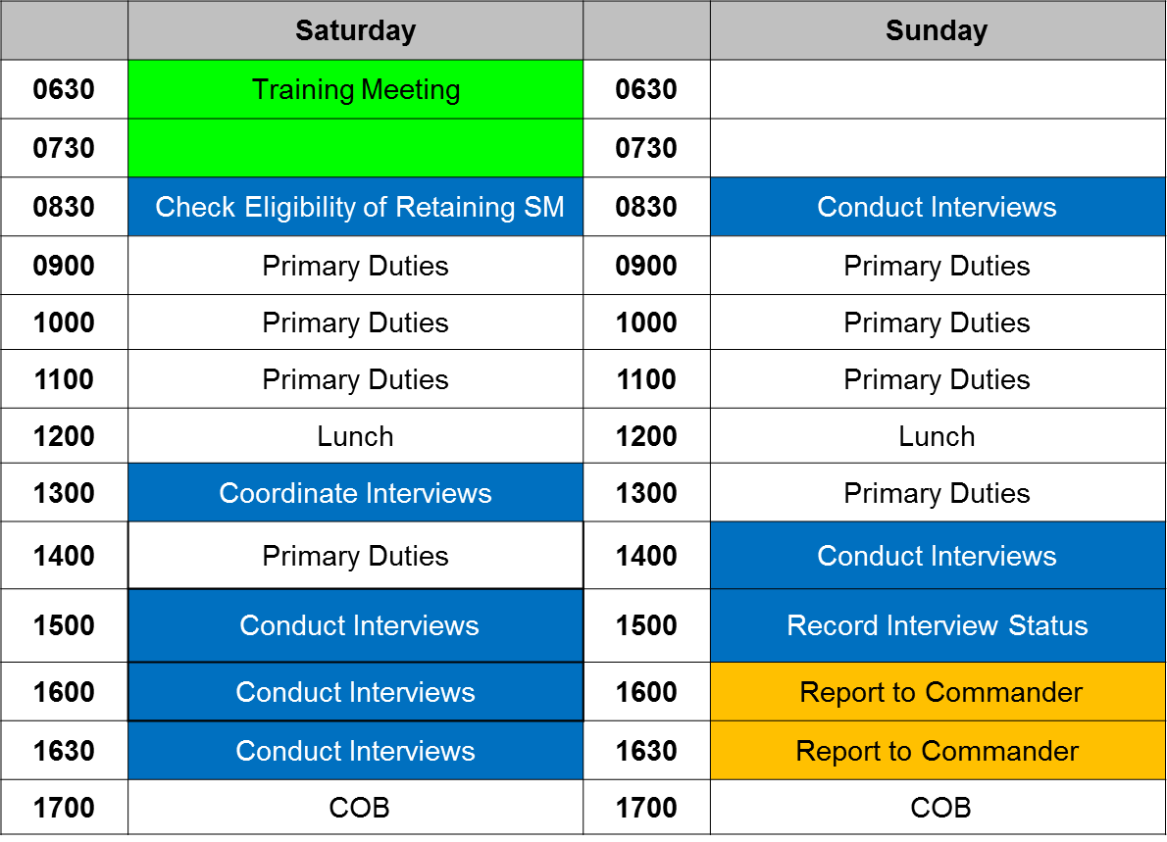
IDT Battle Rhythm

Slide 19
Performance Steps
Discuss the Unit Strength Maintenance Program with unit Leadership:
Mission/Goals
Family Readiness
Soldier care/NCOES
Unit Sponsorship Program
Employer support of the Guard and Reserves (ESGR)

Slide 20
Performance Steps
Validate the Units SM program addresses the following:
Policies and Standard Operating Procedures
Extension/Immediate reenlistment objectives
Responsibilities of unit Leaders
Retention Binder
Sponsorship and orientation programs
Bars to extension/immediate reenlistment
Family programs
ESGR training and support

Slide 21
Performance Steps
Evaluate retention related areas:
Drill Attendance
Retention Objectives
Extensions
Unsatisfactorily participants
Identify positive/negative trends by comparing the information gathered with published objectives, goals, and standards set by the Commander

Slide 22
RMS
Unit Retention NCO Battle Rhythm
UNCLASSIFIED
Unit Retention NCO Battle Rhythm
CW3 Todd J. Libby
MEARNG State Retention Manager (207) 430-5588
todd.j.libby.mil@mail.mil
The Right Number, Right People, and Right Care equals Personnel Readiness

Slide 23
Unit Retention NCO Battle Rhythm
Task: Retention Management Software (RMS) – Unit Retention NCO Battle Rhythm
Condition: Given a Student class of newly assigned Unit Retention
NCO’s, Battalion Career Counselor’s and Recruiting and Retention NCO’s in a classroom environment where instruction is presented formally while questions and discussions are encouraged. Reference materials available will include NGR 601-1, Retention Leader Guide and Unit Retention NCO Battle Rhythm Handout. Students require current RMS account and access. Risk assessment is low and has been conducted/submitted.
Standard: At the conclusion of this block of instruction, Students should possess enough knowledge to establish an immediate Battle Rhythm. utilizing RMS at home station. For an overall “GO” of this learning objective, the Student must achieve 70% or higher on the multiple choice examination at the end of this training session.

Slide 24
Unit Retention NCO Battle Rhythm
Definition of Battle Rhythm
Battle-Rhythm. Noun. (plural battle rhythms) A daily routine or order of business, especially as assumed by a military organization or during crisis.
Unit Retention NCO Battle Rhythm is an Order of Business

Slide 25
Unit Retention NCO Battle Rhythm
Specified Tasks (*)
NGR 601-1 Army National Guard Strength Maintenance Program
Cited Regulation: NGR 601-1, Chapter 2, Paragraph 2-10, Subparagraph b. (9)
2-10. Career Counselors (Battalions/Unit/Forward Deployed)
b. Unit Career Counselor. The Unit Career Counselor is an additional duty position, appointed on orders by the Unit Commander. The position is MOS immaterial. The Unit Career Counselor plays a critical role in SM by assisting the Commander, the First Sergeant, FTS, FLL’s and the Recruiting and Retention NCO (RRNCO) in implementing the unit SM plan. Unit Career Counselors will:
(9) Utilize RMS to coordinate with FTS personnel to ensure that extension documents are completed accurately and in a timely manner. (*)

Slide 26
Unit Retention NCO Battle Rhythm
Specified Tasks (*)
NGR 601-1 Army National Guard Strength Maintenance Program
Cited Regulation: NGR 601-1, Chapter 2, Paragraph 2-20, Subparagraph q. (1)-(3)
2-20. Recruiting and Retention NCO
q. Utilize RMS to track and monitor (*) the following information:
Identification of all Soldiers in the 365 day ETS window (*)
Each Soldiers intention regarding extension (*)
Complete summary of why any Soldier is undecided or plans to ETS if no intention to extend/re-enlist (*)

Slide 27
Unit Retention NCO Battle Rhythm
Implied Tasks
Retention Leader Guide (RLG) dated 31 January 2019
Cited references: RLG, Chapter 8, Paragraph 8-7., a - c.
RLG, Chapter 2, Paragraph 2-1., c.
RLG, Chapter 2, Paragraph 2-1., b.
RLG, Chapter 8, Paragraph 8-10.
Determine Retention Battle Rhythm
Develop Retention Battle Rhythm
Define Roles and Responsibilities by publishing Retention Battle Rhythm
8-10. ……The retention battle rhythm should include all tasks within RMS and also any tasks that are completed outside of RMS, such as the actual interview.

Slide 28
Unit Retention NCO Battle Rhythm
Develop Retention Battle Rhythm
Retention Leader Guide dated 31 January 2019
Cited reference: RLG, Chapter 2, Paragraph 2-1., c.
Developing your retention battle rhythm tasks starts with RSP Battle Hand-
Off or Sponsorship and ends with exit interviews. Tasks are identified for:
RSP Battle Hand-Off
Sponsorship Program
Career Development Program
Annual Retention Briefings
Extension Interviews
Required Retention Counseling
Processing Extension Documents
Processing Extension Waivers
Final Formation (if applicable)
Exit Interviews and Surveys

Slide 29
Unit Retention NCO Battle Rhythm
Define Roles and Responsibilities by Publishing Retention Battle Rhythm
Retention Leader Guide dated 31 January 2019
Cited reference: RLG, Chapter 2, Paragraph 2-1., b.
b. Provide the connection between roles and responsibilities by publishing a retention battle rhythm.
This battle rhythm ensures that all retention tasks are well defined and communicated and include:
Retention Task
Team Member(s) responsible
Frequency or timing
Task Performance Standard
Retention task performance standards that are identified as part of the retention battle rhythm is simply a way of letting your task organization know what you are looking at and what results you are expecting to see.
An example would be letting unit retention NCO’s know that the expectation is that all Soldiers will have their intention recorded sometime in the 365-450 day window and that you will be checking to see if it’s happening.

Slide 30
Unit Retention NCO Battle Rhythm
Retention Interview Timeline
“Y” indicates Soldier wishes to Extend – Prepare/Sign DA 4836
“N” indicates Soldier has not made decision to extend – Continue Interviews/Counseling
Y Y Y Y Y Y Y Y N N N N N N N N
Y Y Y
N N N
Y
Y
N
N
ETS
RRNCO
& UCC
RRNCO
& UCC
RRNCO
& UCC
RRNCO
& UCC
First Line Leader
RRNCO
& UCC
RRNCO
& UCC
1SG
RRNCO
& UCC
RRNCO
& UCC
CO
Troop Battery CDR
Clear Unit
Last Drill
450
365
330
300
270
240
210
180
150
120
90
60
30
1 Jul Sep
Oct Drill
Nov
Dec
Jan
Feb
Mar
Apr
May
Jun
Jul
Aug
450, 365, 270, 180, 120, 90, 60, 30 are ETS Window “work buckets” within RMS.
SOP/Guidance should state when ETS Counseling is conducted and DA 4856 is
loaded into RMS. The example above sets “270” as that date.
NGR 601-1, Chapter 6, Paragraph 6-14 ……Commanders, 1SGs, FLLs and RRNCOs will
ensure all ARNG Soldiers, including ING members are interviewed and counseled.

Slide 31
Pre, During and Post Drill Actions
Sun | Mon | Tue | Wed | Thu | Fri | Sat
 |  |  | 1 | 2 | 3 | 4
5 | 6 | 7 | 8 | 9 – PRE IADT TRNG MTG | 10 | 11
12 | 13 | 14 | 15 | 16 | 17 | 18 – DRILL MUTA 4 Home Stat
19 – DRILL MUTA 4 Home Stat | 20 | 21 | 22 | 23 | 24 – POST IADT Close Out | 25
26 | 27 | 28 | 29 | 30 | 31
9th – Pre IADT Training Meeting: URNCO & RRNCO update status on Retention & Attrition and provide information on upcoming scheduled interviews/counseling at Drill. If applicable brief new member Sponsorship.
18-19 – Drill: Provide by name list of Soldiers to each Interviewer at Pre-Drill Training Meeting. Update information in RMS as it becomes available. Prepare extension documents. Upload Counseling. Record Intent.
24th – Post IADT Close Out: Work with Readiness NCO to ensure all extension actions for drill have been finalized and uploaded into RMS.

Slide 32
Attrition Management Programs

Slide 33
Terminal Learning Objective
Action: Identify Attrition Management Programs
Conditions: In a classroom environment with access to NGR 601-1, NG Pam 601-1, Retention Leaders Guide, ESGR Job Aid, applicable PPOMs and Executive Summary of Task 60.
Standard: Identify Attrition Management Programs that will reduce the number of attrition losses in Army National Guard Units.

Slide 34
Sponsorship
NGR 601-1
Para 1-5 (2)
Para 6-11
Para 2-10 a. (1) (7)
Para 2-10 b. (6)
NG Pam 601-1
Para 3-3
Para 3-5
PPOM 19-035
Paragraphs 2 - 8
Retention Leaders Guide
Para 5-3 (a-e)

Slide 35
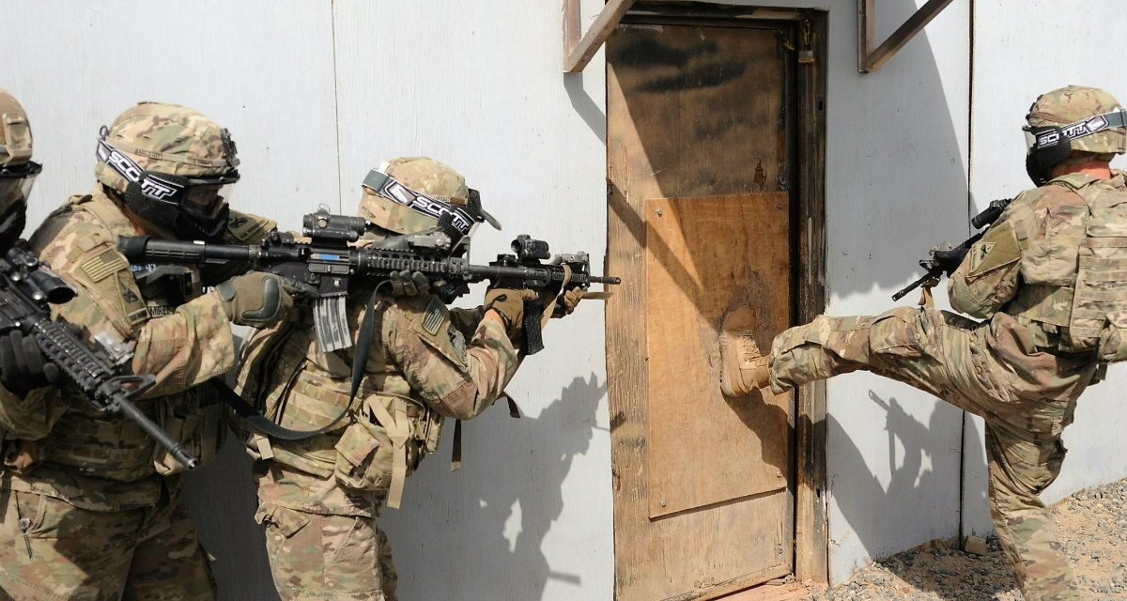
AWOL Recovery

Slide 36
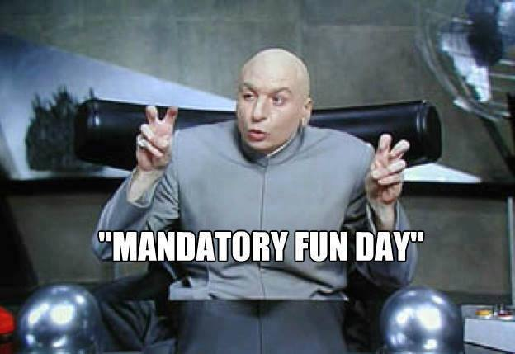
Family Readiness

Slide 37
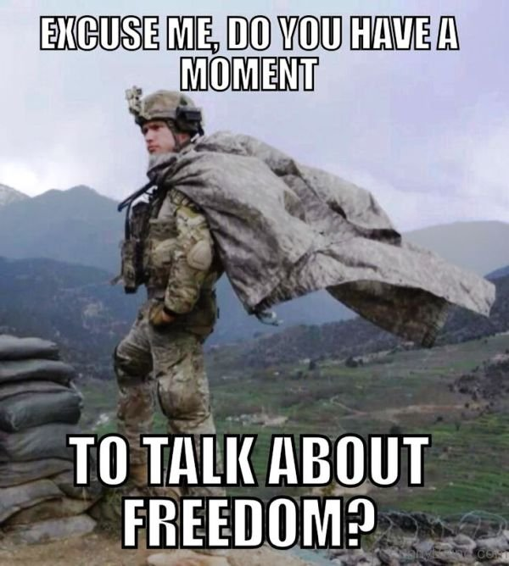
ESGR

Slide 38
Questions?
Thus far

